Slide 1
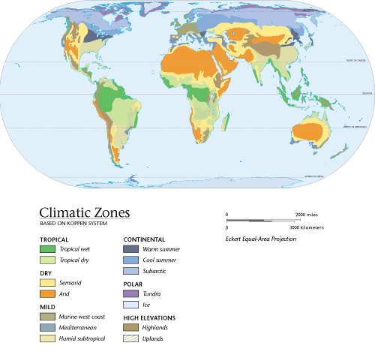
Section 1
What Is Climate?
What Is Weather? Weather is the condition of the atmosphere at a particular time.
What Is Climate? Climate is the average weather condition in an area over a long period of time.
Copyright © by Holt, Rinehart and Winston. All rights reserved.
Notes:
Header first line (section#) – white 24 points Arial Bold
Header second line (title) – white 28 points Arial Bold
Title – yellow 28 points Arial Bold
Body text – white24 points Arial and Arial Bold
Bullets – yellow
Copyright – white 12 points Arial
Background name: HST-Presentation_blue.jpg,
Size:
Height: 7.52"
Width: 10.02"
Scale: 70%
Position on slide:
Horizontal - 0"
Vertical - 0"

Slide 2
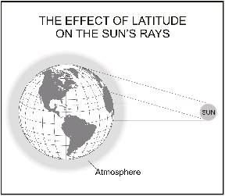
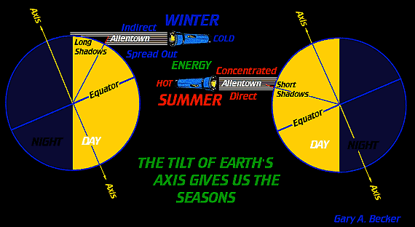
Latitude
What Is Climate?
Solar Energy and Latitude The amount of direct solar energy a particular area receives is determined by latitude.
Seasons and Latitude Seasons happen because the Earth is tilted on its axis at a 23.5° angle. This tilt affects how much solar energy an area receives as Earth moves around the sun.
End of Slide
Copyright © by Holt, Rinehart and Winston. All rights reserved.
Notes:
Header first line (section#) – white 24 points Arial Bold
Header second line (title) – white 28 points Arial Bold
Title – yellow 28 points Arial Bold
Body text – white24 points Arial and Arial Bold
Bullets – yellow
Copyright – white 12 points Arial
Background name: HST-Presentation_blue.jpg,
Size:
Height: 7.52"
Width: 10.02"
Scale: 70%
Position on slide:
Horizontal - 0"
Vertical - 0"

Slide 3
Section 1
The Seasons
Copyright © by Holt, Rinehart and Winston. All rights reserved.
Notes:
Header first line (section#) – white 24 points Arial Bold
Header second line (title) – white 28 points Arial Bold
Title – navy 28 points Arial Bold
Body text – black 24 points Arial and Arial Bold
Bullets – navy
Copyright – white 12 points Arial
Background name: HST-Presentation_white.jpg
Size:
Height: 7.52"
Width: 10.02"
Scale: 70%
Position on slide:
Horizontal - 0"
Vertical - 0"

Slide 4
Prevailing Winds
What Are Prevailing Winds? Winds that blow mainly from one direction are prevailing winds. The circulation of warm and cold air, as shown on the next slide, are the causes behind prevailing winds.
Mountains
How Do Mountains Affect Climate? Mountains can influence an area’s climate by affecting both temperature and precipitation.
Copyright © by Holt, Rinehart and Winston. All rights reserved.
Notes:
Header first line (section#) – white 24 points Arial Bold
Header second line (title) – white 28 points Arial Bold
Title – yellow 28 points Arial Bold
Body text – white24 points Arial and Arial Bold
Bullets – yellow
Copyright – white 12 points Arial
Background name: HST-Presentation_blue.jpg,
Size:
Height: 7.52"
Width: 10.02"
Scale: 70%
Position on slide:
Horizontal - 0"
Vertical - 0"

Slide 5
Section 1
The Circulation of Warm and Cold Air
Copyright © by Holt, Rinehart and Winston. All rights reserved.
Notes:
Header first line (section#) – white 24 points Arial Bold
Header second line (title) – white 28 points Arial Bold
Title – navy 28 points Arial Bold
Body text – black 24 points Arial and Arial Bold
Bullets – navy
Copyright – white 12 points Arial
Background name: HST-Presentation_white.jpg
Size:
Height: 7.52"
Width: 10.02"
Scale: 70%
Position on slide:
Horizontal - 0"
Vertical - 0"

Slide 6
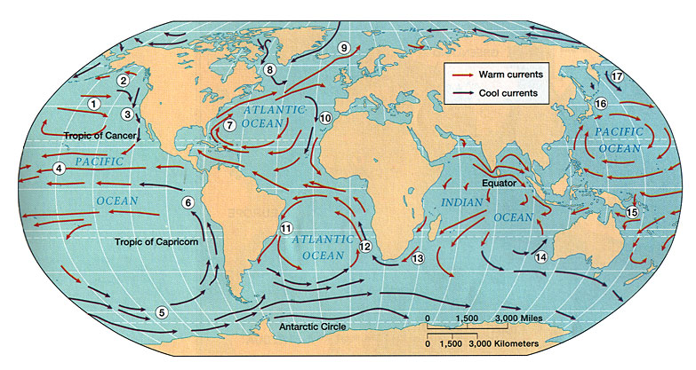
Section 1
Large Bodies of Water
Regulating Effect of Water Large bodies of water can influence an area’s climate. Water absorbs and releases heat slower than land does. Because of this quality, water helps to moderate the temperatures of the land around it.
Ocean Currents
How Do Ocean Currents Affect Climate? As surface currents move, they carry warm or cool water to different locations. The surface temperature of the water affects the temperature of the air above it.
Copyright © by Holt, Rinehart and Winston. All rights reserved.
Notes:
Header first line (section#) – white 24 points Arial Bold
Header second line (title) – white 28 points Arial Bold
Title – yellow 28 points Arial Bold
Body text – white24 points Arial and Arial Bold
Bullets – yellow
Copyright – white 12 points Arial
Background name: HST-Presentation_blue.jpg,
Size:
Height: 7.52"
Width: 10.02"
Scale: 70%
Position on slide:
Horizontal - 0"
Vertical - 0"

Slide 7
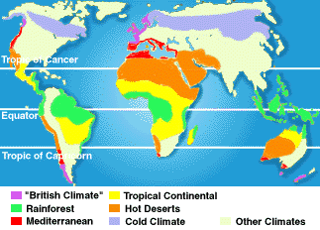
Section 1
What Is Climate?
Climates of the World
Adapting to a Climate Plants and animals that have adapted to one climate may not be able to live in another climate.
Climate Zones The Earth’s three major climate zones— tropical, temperate, and polar—are shown on the next slide.
End of Slide
Copyright © by Holt, Rinehart and Winston. All rights reserved.
Notes:
Header first line (section#) – white 24 points Arial Bold
Header second line (title) – white 28 points Arial Bold
Title – yellow 28 points Arial Bold
Body text – white24 points Arial and Arial Bold
Bullets – yellow
Copyright – white 12 points Arial
Background name: HST-Presentation_blue.jpg,
Size:
Height: 7.52"
Width: 10.02"
Scale: 70%
Position on slide:
Horizontal - 0"
Vertical - 0"

Slide 8
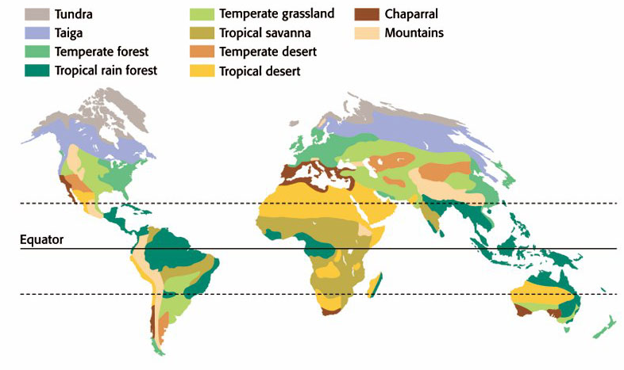
Section 1
Earth’s Land Biomes
Copyright © by Holt, Rinehart and Winston. All rights reserved.
Notes:
Header first line (section#) – white 24 points Arial Bold
Header second line (title) – white 28 points Arial Bold
Title – navy 28 points Arial Bold
Body text – black 24 points Arial and Arial Bold
Bullets – navy
Copyright – white 12 points Arial
Background name: HST-Presentation_white.jpg
Size:
Height: 7.52"
Width: 10.02"
Scale: 70%
Position on slide:
Horizontal - 0"
Vertical - 0"

Slide 9
Section 2
The Tropics
The Tropical Zone
Tropical Rain Forests Tropical rain forests are always warm and wet. Because they are located near the equator, they receive strong sunlight year-round.
Tropical Savannas Tropical savannas, or grasslands, are composed of tall grasses and a few scattered trees.
Tropical Deserts Many hot deserts, such as the Sahara, in Africa, are tropical deserts. Daily temperatures in tropical deserts often vary from very hot daytime temperatures to cool nighttime temperatures.
End of Slide
Copyright © by Holt, Rinehart and Winston. All rights reserved.
Notes:
Header first line (section#) – white 24 points Arial Bold
Header second line (title) – white 28 points Arial Bold
Title – yellow 28 points Arial Bold
Body text – white24 points Arial and Arial Bold
Bullets – yellow
Copyright – white 12 points Arial
Background name: HST-Presentation_blue.jpg,
Size:
Height: 7.52"
Width: 10.02"
Scale: 70%
Position on slide:
Horizontal - 0"
Vertical - 0"

Slide 10
Section 3
Temperate and Polar Zones
The Temperate Zone
Temperate Forests The temperate forest biomes tend to have high amounts of rainfall and seasonal temperature differences.
Temperate Grasslands Temperate grasslands are regions that receive too little rainfall for trees to grow. This biome has warm summers and cold winters.
Chaparrals Chaparral regions have cool, wet winters and hot, dry summers.
Temperate Deserts The temperate desert biomes tend to be cold deserts.
End of Slide
Copyright © by Holt, Rinehart and Winston. All rights reserved.
Notes:
Header first line (section#) – white 24 points Arial Bold
Header second line (title) – white 28 points Arial Bold
Title – yellow 28 points Arial Bold
Body text – white24 points Arial and Arial Bold
Bullets – yellow
Copyright – white 12 points Arial
Background name: HST-Presentation_blue.jpg,
Size:
Height: 7.52"
Width: 10.02"
Scale: 70%
Position on slide:
Horizontal - 0"
Vertical - 0"

Slide 11
Section 3
Temperate and Polar Zones
The Polar Zone
Tundra The tundra biome has long, cold winters with almost 24 hours of night. It also has short, cool summers with almost 24 hours of daylight.
Taiga (Northern Coniferous Forest) The taiga has long, cold winters and short, warm summers.
End of Slide
Copyright © by Holt, Rinehart and Winston. All rights reserved.
Notes:
Header first line (section#) – white 24 points Arial Bold
Header second line (title) – white 28 points Arial Bold
Title – yellow 28 points Arial Bold
Body text – white24 points Arial and Arial Bold
Bullets – yellow
Copyright – white 12 points Arial
Background name: HST-Presentation_blue.jpg,
Size:
Height: 7.52"
Width: 10.02"
Scale: 70%
Position on slide:
Horizontal - 0"
Vertical - 0"

Slide 12
Section 3
Temperate and Polar Zones
Microclimates
What Is a Microclimate? A microclimate is a climate of a small area.
Cities Cities are microclimates. In a city, temperatures can be 1° C to 2° C warmer than the surrounding rural areas.
End of Slide
Copyright © by Holt, Rinehart and Winston. All rights reserved.
Notes:
Header first line (section#) – white 24 points Arial Bold
Header second line (title) – white 28 points Arial Bold
Title – yellow 28 points Arial Bold
Body text – white24 points Arial and Arial Bold
Bullets – yellow
Copyright – white 12 points Arial
Background name: HST-Presentation_blue.jpg,
Size:
Height: 7.52"
Width: 10.02"
Scale: 70%
Position on slide:
Horizontal - 0"
Vertical - 0"

Slide 13
Section 4
Changes in Climate
Ice Ages
Glacial Periods During glacial periods, the enormous sheets of ice advanced.
Interglacial Periods Warmer times that happen between glacial periods are called interglacial periods.
Motions of the Earth There are many theories about the causes of ice ages. One theory is illustrated on the next slide.
Plate Tectonics The Earth’s climate is further influenced by plate tectonics and continental drift.
End of Slide
Copyright © by Holt, Rinehart and Winston. All rights reserved.
Notes:
Header first line (section#) – white 24 points Arial Bold
Header second line (title) – white 28 points Arial Bold
Title – yellow 28 points Arial Bold
Body text – white24 points Arial and Arial Bold
Bullets – yellow
Copyright – white 12 points Arial
Background name: HST-Presentation_blue.jpg,
Size:
Height: 7.52"
Width: 10.02"
Scale: 70%
Position on slide:
Horizontal - 0"
Vertical - 0"

Slide 14
Section 4
The Milankovitch Theory
Copyright © by Holt, Rinehart and Winston. All rights reserved.
Notes:
Header first line (section#) – white 24 points Arial Bold
Header second line (title) – white 28 points Arial Bold
Title – navy 28 points Arial Bold
Body text – black 24 points Arial and Arial Bold
Bullets – navy
Copyright – white 12 points Arial
Background name: HST-Presentation_white.jpg
Size:
Height: 7.52"
Width: 10.02"
Scale: 70%
Position on slide:
Horizontal - 0"
Vertical - 0"

Slide 15
Section 4
Changes in Climate
Volcanic Eruptions
Catastrophes Influence Climate Many natural factors can affect global climate. Catastrophic events, such as volcanic eruptions, can influence climate.
Asteroid Impact
Dramatic Climatic Change Scientists believe that if an asteroid this big hit the Earth, it could change the climate of the entire world.
End of Slide
Copyright © by Holt, Rinehart and Winston. All rights reserved.
Notes:
Header first line (section#) – white 24 points Arial Bold
Header second line (title) – white 28 points Arial Bold
Title – yellow 28 points Arial Bold
Body text – white24 points Arial and Arial Bold
Bullets – yellow
Copyright – white 12 points Arial
Background name: HST-Presentation_blue.jpg,
Size:
Height: 7.52"
Width: 10.02"
Scale: 70%
Position on slide:
Horizontal - 0"
Vertical - 0"

Slide 16
Section 4
Changes in Climate
The Sun’s Cycle
Changes in the Sun Some changes in the climate can be linked to changes in the sun.
Turning Up the Heat When the sun is at its solar maxi-mum, it produces a large percentage of high-energy radiation. This increase in high-energy radiation warms the winds in the atmosphere. This change in turn affects climate patterns around the world.
End of Slide
Copyright © by Holt, Rinehart and Winston. All rights reserved.
Notes:
Header first line (section#) – white 24 points Arial Bold
Header second line (title) – white 28 points Arial Bold
Title – yellow 28 points Arial Bold
Body text – white24 points Arial and Arial Bold
Bullets – yellow
Copyright – white 12 points Arial
Background name: HST-Presentation_blue.jpg,
Size:
Height: 7.52"
Width: 10.02"
Scale: 70%
Position on slide:
Horizontal - 0"
Vertical - 0"

Slide 17
Section 4
Changes in Climate
Global Warming
Greenhouse Effect The Earth’s natural heating process, in which gases in the atmosphere trap thermal energy, is called the greenhouse effect.
Consequences of Global Warming Many scientists think that if the global temperature continues to rise, the ice caps will melt and cause flooding.
End of Slide
Copyright © by Holt, Rinehart and Winston. All rights reserved.
Notes:
Header first line (section#) – white 24 points Arial Bold
Header second line (title) – white 28 points Arial Bold
Title – yellow 28 points Arial Bold
Body text – white24 points Arial and Arial Bold
Bullets – yellow
Copyright – white 12 points Arial
Background name: HST-Presentation_blue.jpg,
Size:
Height: 7.52"
Width: 10.02"
Scale: 70%
Position on slide:
Horizontal - 0"
Vertical - 0"

Slide 18
Chapter 17
Climate
Concept Map
Use the following terms to complete the concept map on the next slide: ocean currents, seasons, latitude, climate, prevailing winds, curved, mountains, large bodies of water.
Copyright © by Holt, Rinehart and Winston. All rights reserved.
Notes:
Header first line (section#) – white 24 points Arial Bold
Header second line (title) – white 28 points Arial Bold
Title – yellow 28 points Arial Bold
Body text – white24 points Arial and Arial Bold
Bullets – yellow
Copyright – white 12 points Arial
Background name: HST-Presentation_blue.jpg,
Size:
Height: 7.52"
Width: 10.02"
Scale: 70%
Position on slide:
Horizontal - 0"
Vertical - 0"

Slide 19
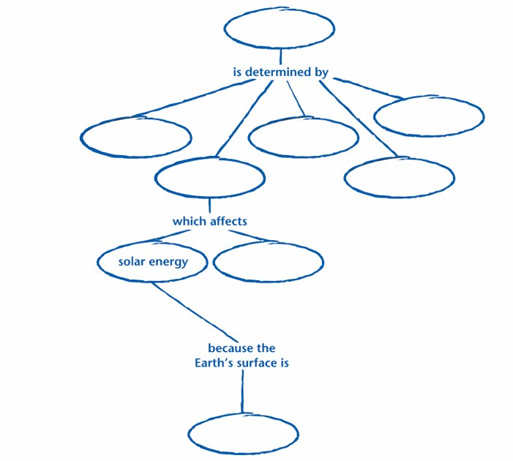
Chapter 17
Concept Map
Copyright © by Holt, Rinehart and Winston. All rights reserved.
Notes:
Header first line (section#) – white 24 points Arial Bold
Header second line (title) – white 28 points Arial Bold
Title – navy 28 points Arial Bold
Body text – black 24 points Arial and Arial Bold
Bullets – navy
Copyright – white 12 points Arial
Background name: HST-Presentation_white.jpg
Size:
Height: 7.52"
Width: 10.02"
Scale: 70%
Position on slide:
Horizontal - 0"
Vertical - 0"

Slide 20
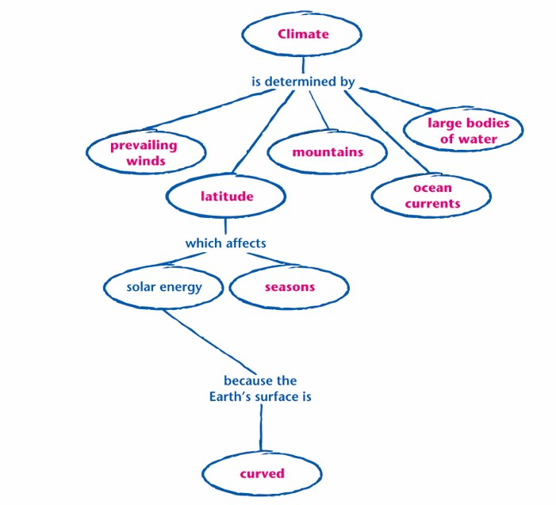
Chapter 17
Concept Map
Copyright © by Holt, Rinehart and Winston. All rights reserved.
Notes:
Header first line (section#) – white 24 points Arial Bold
Header second line (title) – white 28 points Arial Bold
Title – navy 28 points Arial Bold
Body text – black 24 points Arial and Arial Bold
Bullets – navy
Copyright – white 12 points Arial
Background name: HST-Presentation_white.jpg
Size:
Height: 7.52"
Width: 10.02"
Scale: 70%
Position on slide:
Horizontal - 0"
Vertical - 0"

